Slide 1
Disclaimer
These slides are intended as presentation aids for the lecture. They contain information that would otherwise be to difficult or time-consuming to reproduce on the board. But they are incomplete, not self-explanatory, and are not always used in the order they appear in this presentation. As a result, these slides should not be used as a script for this course. I recommend you take notes during class, maybe on the slides themselves. It has been shown that taking notes improves learning success.

Slide 2
Reading for this set of slides
Craig – Intro to Robotics (3rd Edition)
Chapter 5.10
Please note that this set of slides is intended as support for the lecture, not as a
stand-alone script. If you want to study for this course, please use these slides
in conjunction with the indicated chapters in the text books. The textbooks are
available online or in the TUB library (many copies that can be checked out for the entire semester. There are also some aspects of the lectures that will not be
covered in the text books but can still be part of the homework or exam. For those
It is important that you attend class or ask somebody about what was covered in class.

Slide 3
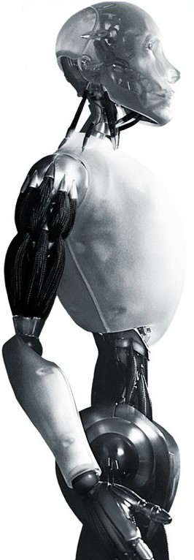
Robotics The Jacobian and Forces
TU Berlin
Oliver Brock
TexPoint fonts used in EMF.
Read the TexPoint manual before you delete this box.: AAAAAAAAAAAAA

Slide 4


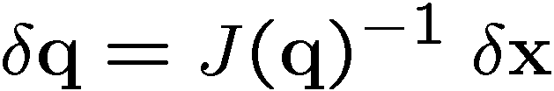
What the Jacobian can do…

Slide 5
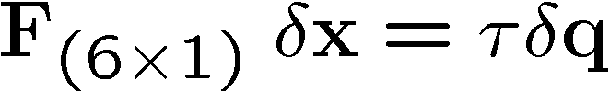
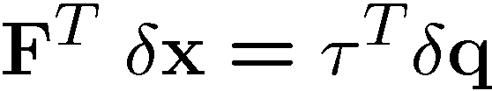
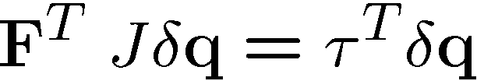


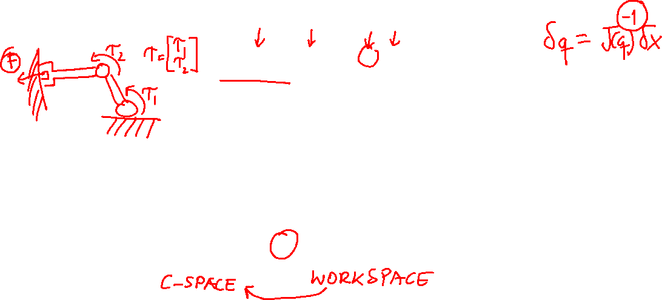
Jacobian and Forces
work = force ¢ distance
virtual work: virtual displacements with real force (or vice versa)
using matrix notation
using
Notes:
http://en.wikipedia.org/wiki/Virtual_work
The principle of virtual work states that the virtual work of the applied forces is zero for all virtual movements of the system from static equilibrium. This principle can be generalized such that three dimensional rotations are included: the virtual work of the applied forces and applied moments is zero for all virtual movements of the system from static equilibrium.

Slide 6



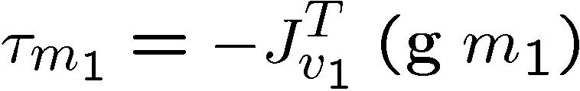


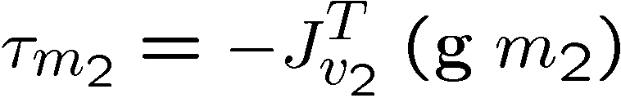
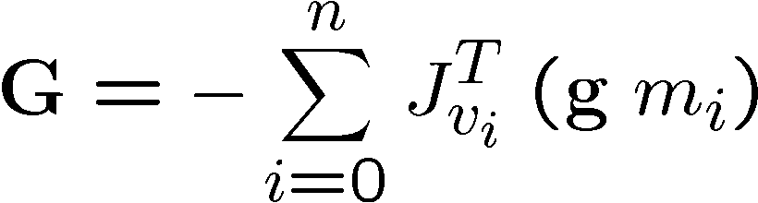
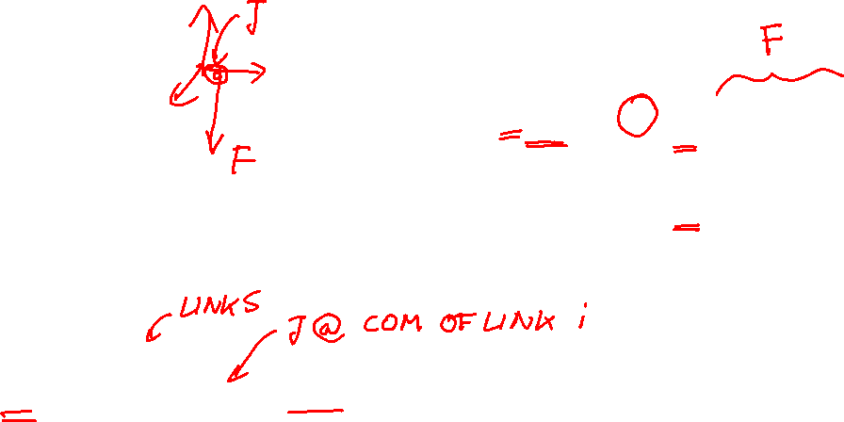
Gravity Reloaded: With Jacobian
Linear part of Jacobian at Center of Mass 1

Slide 7
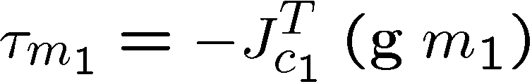

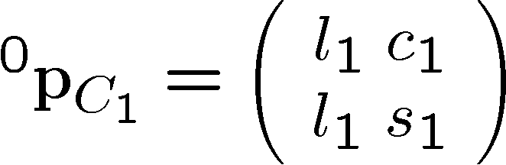
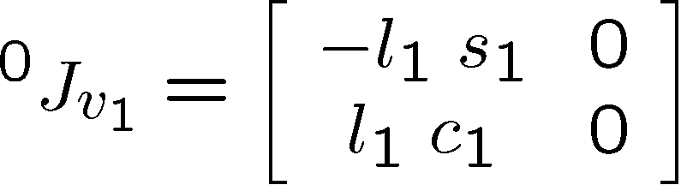
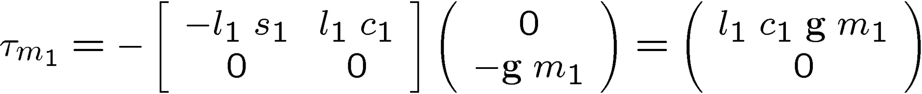
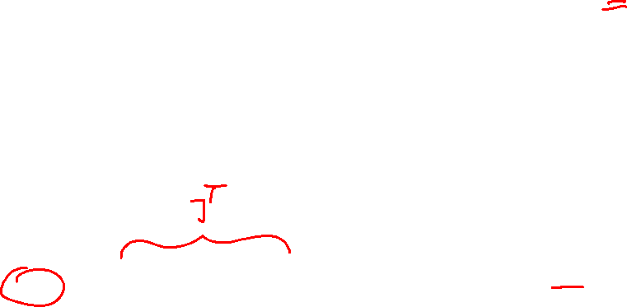
Gravity Example

Slide 8

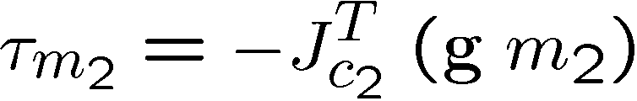
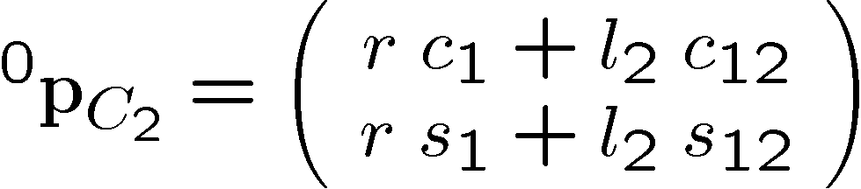

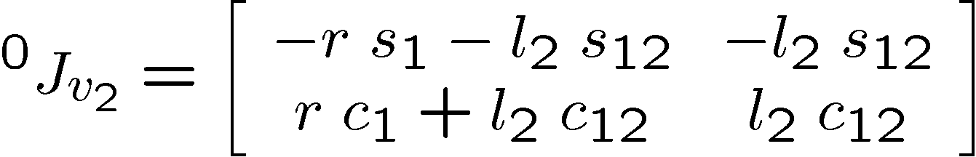
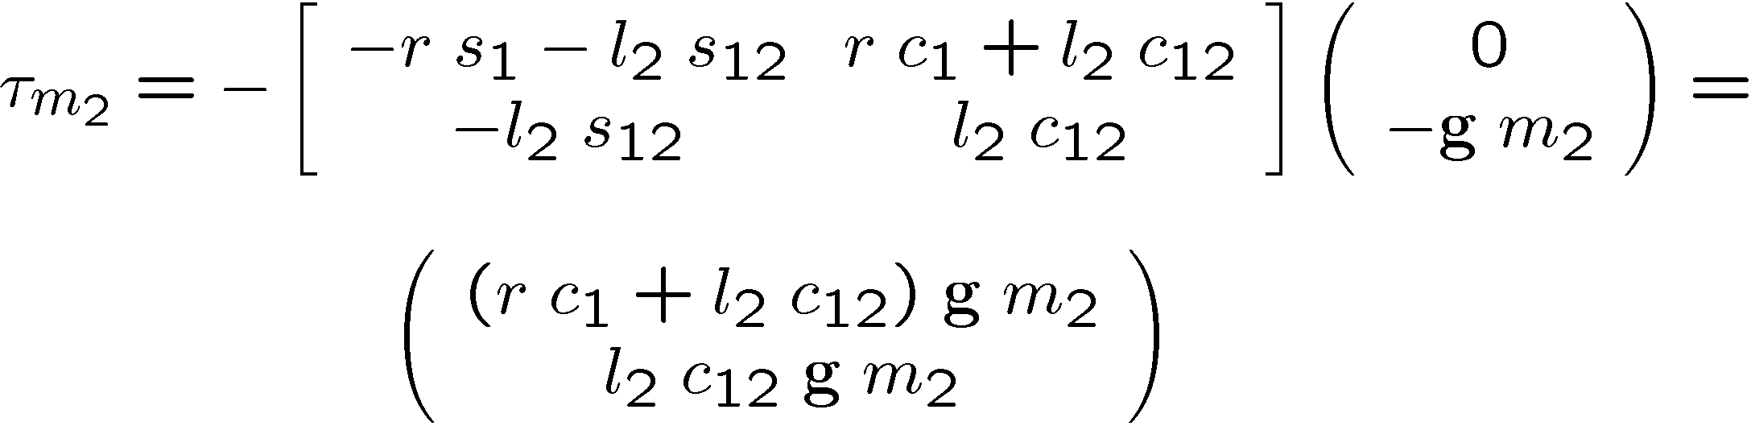
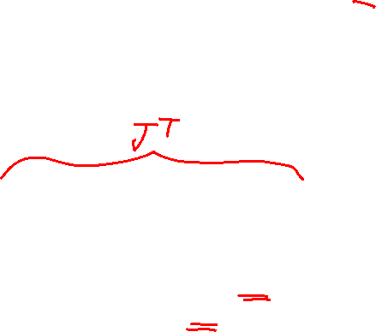
Gravity Example cont.

Slide 9
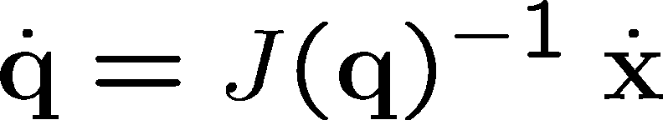

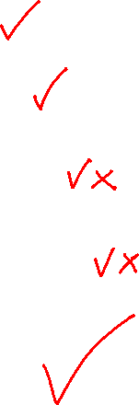
What the Jacobian can do…
My favorite formula!

Slide 10

Notes:
q ---- forward kinematics ----> x
<---- inverse kinematics ----
\dot{q} ----- \dot{x} = J \dot{q} ----> \dot{x}
\dot(q} = J^{-1} \dot{x}
F = J^{-T} \tau
\tau <----- \tau = J^T F ---- F
Background image
https://www.pexels.com/photo/background-black-blackboard-board-159770/

